Slide 1
SWE 4803
Lec – 5 -2

Slide 2
Plan Cost Management
The process of defining how the project costs will be estimated, budgeted, managed, monitored, and controlled
Process
Output
Plan cost management
Cost Management Plan

Slide 3
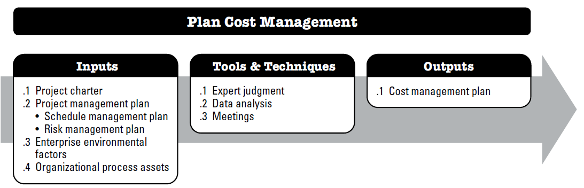
Plan Cost Management
it provides guidance and direction on how the project costs will be managed throughout the project.
This process is performed once or at predefined points in the project.

Slide 4
Plan Cost Management
Input:
Project charter
The project charter provides the preapproved financial resources from which the detailed project costs are developed.
Project Mgt plan
Schedule management plan: The schedule management plan provides processes and controls that will impact cost estimation and management.
EEF & OPA
EEF - Organizations culture, market condition, exchange rate, PMIS etc
OPA - Financial controls procedures (e.g., time reporting, required expenditure and disbursement reviews), Historical information and lessons learned repository; Financial databases; and Existing formal and informal cost estimating and budgeting-related policies, procedures, and guidelines.
The project charter also defines the project approval requirements that will influence the management of the project costs.
Risk management plan: The risk management plan provides processes and controls that will impact cost estimation and management.

Slide 5
Plan Cost Management
Tools & Techniques:
Expert judgment
Previous similar projects;
Data Analysis
Alternatives analysis can include reviewing strategic funding options such as: self-funding, funding with equity, or funding with debt.
Meetings
Project team may hold meetings to develop the cost management plan
Information in the industry, discipline, and application area;
Cost estimating and budgeting; and
Earned value management.

Slide 6
Plan Cost Management
Output:
Cost management plan
Unit of measure: staff hour, meter, liters, tons, kilometers etc
Level of precision : how it will be rounded e.g., 100.49, 100)
Level of accuracy: the acceptable range (e.g., ±10%)
Organizational procedure links: WBS to performing organizations accounting system
Control threshold- Thresholds are typically expressed as percentage deviations from the baseline plan
Rules of performance measurement
Reporting format
Process description etc

Slide 7
Estimate Costs
The process of developing an approximation of the monetary resources needed to complete project activities
it determines the monetary resources required for the project. This process is performed periodically throughout the project as needed.
Process
Output
Estimate Cost
•Cost estimates
•Basis of estimates
•Project documents update

Slide 8
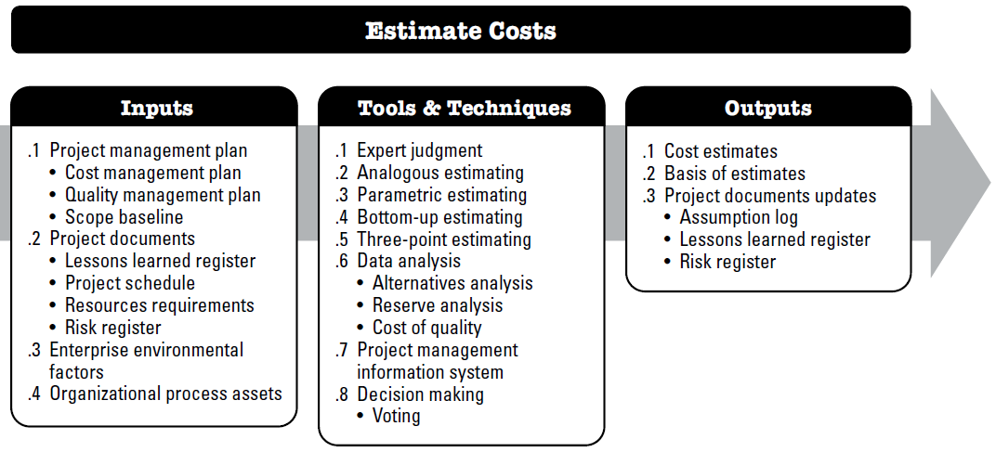
Estimate Costs

Slide 9
Estimate Costs
Input:
Project management plan
Cost management plan
Project documents
Lessons learned register
EEF & OPA
EEF - Market conditions, Published commercial information, Exchange rates and inflation.
OPA - Cost estimating policies, Cost estimating templates, Historical information and lessons learned repository.
Quality management plan
Scope baseline
Project schedule
Resources requirements
Risk register

Slide 10
Estimate Costs
More Precise
- Parametric
- Bottom up
- Three Point (detailed)
Less Precise
- Analogous
Tools & Techniques:
  Expert judgment
  Analogous estimating
  Parametric estimating
  Bottom-up estimating
  Three-point estimating
  Data analysis
  PMIS
  Decision making

Slide 11
Estimate Costs
 | Analogous Estimation | Parametric Estimation
Method | Use historic data of previous similar projects. | Use formula on historic data of previous project.
When? | early phases of the project when only high-level data can be used. | when detailed data is available.
Utility | Only when data from a similar project is available. | Only when a formula, algorithm or statistical model can be devised.
Accuracy | Usually less accurate. Depends on expertise and experience | Usually more accurate. Depends on the accuracy of available data and chosen model
Effort | Usually less costly and time consuming. | Usually more costly and time consuming.

Slide 12
Estimate Costs
Two commonly used formulas are triangular and beta distributions. The formulas are:
  Triangular distribution. cE = (cO + cM + cP) / 3
  Beta distribution. cE = (cO + 4cM + cP) / 6
PERT (Program Evaluation and Review Technique) is based on beta distribution technique and uses an approximate formula to calculate a weighted average of three numbers.
E_ PERT = (cO + 4cM + cP) / 6
PERT was initially developed by US Navy to take care of scheduling uncertainties. The formula mentioned above is a close approximation of mean found by the beta distribution equation.

Slide 13
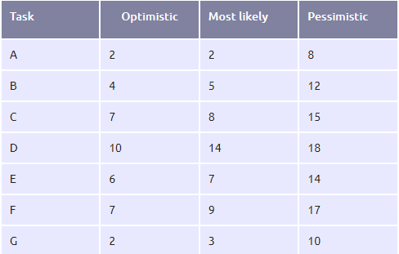
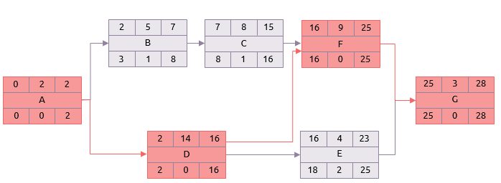
Estimate Costs
PERT (Program Evaluation and Review Technique)
Critical path analysis uses a single-point estimate for all activity durations.
PERT uses a three-point estimate for each activity.
Using the most likely durations in a normal critical path analysis gives the result shown below with the critical path being the sequence: A, D, F, G.

Slide 14
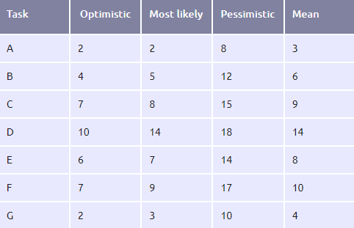
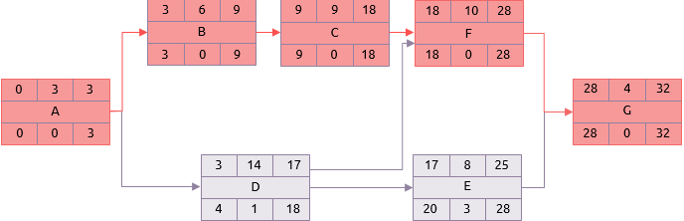
Estimate Costs
PERT (Program Evaluation and Review Technique)
In reality , activities will take somewhere between the optimistic and pessimistic estimates.
PERT uses these estimates to calculate a mean duration based on a Beta distribution.
E_ PERT(Mean Duration) = (dO + 4dM + dP) / 6
Not only has the overall project duration increased to 32, but the critical path has moved. It now comprises tasks A, B, C, F and G.

Slide 15
Estimate Costs
PERT Example and explanation
Let us assume that we have to estimate the time it takes to go from IUT to Uttara. There could be 3 different scenario for going from IUT to Uttara.
Optimistic Scenario – Roads would be free of any traffic congestion and there is likely to be no stopping at traffic signals.
Pessimistic Scenario – There would be serious traffic bottlenecks (may be due to a major accident/Bridge Collapse) or there would be some unscheduled stops (may be due to vehicle breakdown).
Most Likely Scenario – There would be regular traffic conditions.
Let us assume that we evaluated the three scenarios and arrived at 3 estimates:
Optimistic Value (cO): 45 minutes
Pessimistic Value (cP): 225 minutes
Most Likely Value (cM): 90 minutes
in most cases, the trip will take 105 minutes or less.
Putting these values in the formula, we get
E_PERT=(45+225+4×90)/6 = 105 minutes

Slide 16
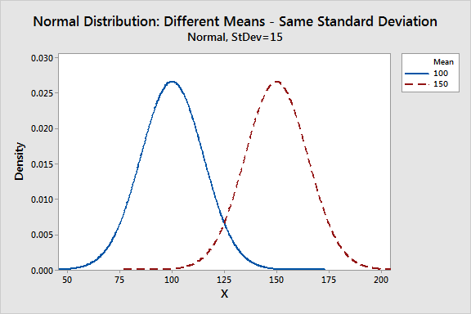
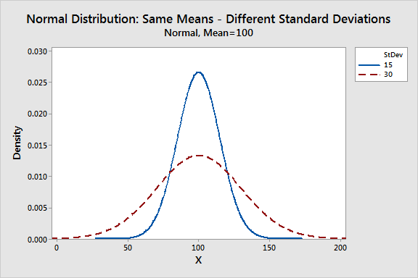
Estimate Costs
PERT with Standard Deviation
The Standard Deviation for PERT can be calculated by using the following formula:
σ = (cP – cO)/6 σ = (225 – 45)/6 σ = 30 minutes
Standard Deviation shows the Variation from the Mean. A low Standard Deviation indicates that the observations (series of numbers) are very close to the Mean.
Consider the following two series:
Series A: (5, 6, 7) Series B: (2, 6, 10)
The mean (simple average) of both the series is 6. However, numbers in the series B are far apart as compared to Series A.

Slide 17
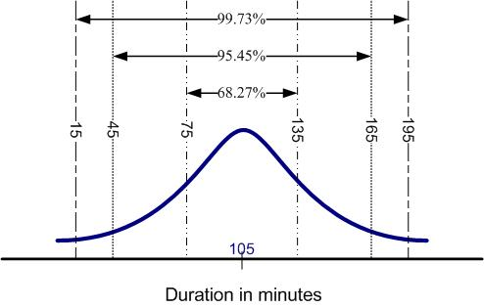
Estimate Costs
PERT with Standard Deviation
what is the Probability of reaching Uttara from IUT in 105 minutes?
Let us assume two things to understand the concept of standard deviation and variation from the mean.
  We have estimated Optimistic, Most Likely, and Pessimistic duration for going from IUT to Uttara.
  Faculty member X made ‘n’ trips from IUT to Uttara in last 5 years. We have the records of the actual time duration of each trip. The time duration for each trip is different. Let us call them observations.
We can plot a graph for these ‘n’ Observation.

Slide 18
Estimate Costs
There are three important things that can be noticed from the above graph:
  Population Density is highest near the Mean, which means a trip is likely to be completed in approximately 105 minutes.
  Almost all trips are completed within 195 minutes.
  It is unlikely that a trip’s duration will be below 15 minutes

Slide 19
Estimate Costs
Let us assume that if we have to make 1 more trip from IUT to Uttara, what would be the duration estimate for such a trip???
we can provide either single estimate or a range of values. A good single estimate could be 105 minutes since Population Density is maximum near 105 minutes.
To be on the safe side, it is better to give a range of values for providing an estimate.
We can use Standard Deviation to determine the range. We can say that duration estimate for one more trip is likely to be in the range of 105±30 minutes. In other words, we can say that the trip would take anywhere between 75 minutes to 135 minutes.

Slide 20
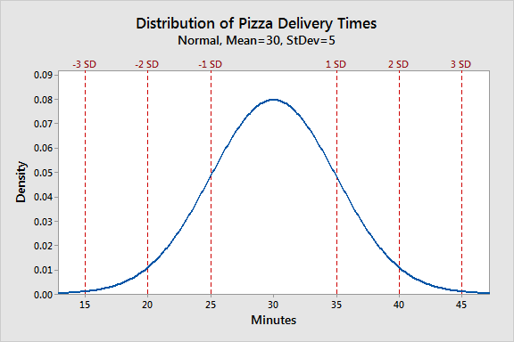
Can You Explain

Slide 21
Estimate Costs
Output:
Cost Estimates
Quantitative assessment of cost required to complete project work
Basis of estimates
How it was developed, assumption, constraints, confidence level, range etc
Project documents update
Assumption log
LL register
Risk register

Slide 22
Determine budget
The process of aggregating the estimated cost of individual activities or work packages to establish an authorized cost baseline.
Process
Output
Determine Budget
Cost baseline
Project funding requirements
Project documents update

Slide 23
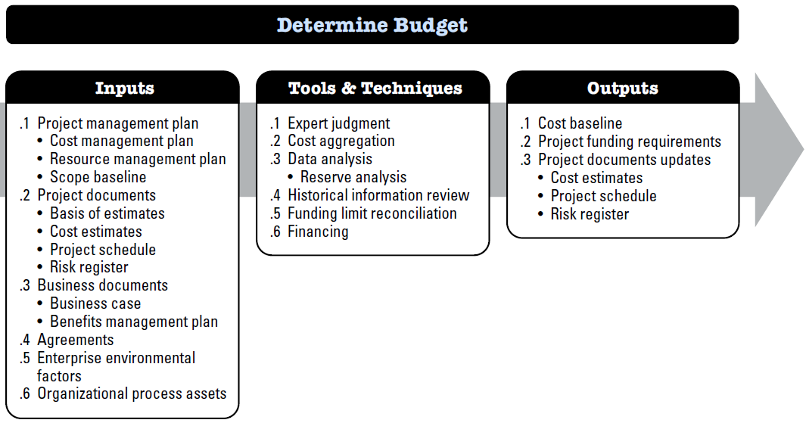
Determine budget

Slide 24
Determine budget
Input:
PROJECT MANAGEMENT PLAN
Cost management plan , Resource management plan , Scope baseline
PROJECT DOCUMENTS
Basis of estimates
Agreements
Applicable agreement and costs relating to products, services, or results that have been or will be purchased are included when determining the budget.
Project schedule
Business case
Business documents
exchange rates.
EEF & OPA
Cost estimates
Benefits management plan
Existing formal and informal cost budgeting-related policies, procedures, and guidelines; Historical information and lessons learned repository.

Slide 25
Determine budget
Tools & Techniques:
    Expert Judgement
    Cost aggregation
    Data Analysis – Reserve Analysis
    Historical Relationship
    Fund limit reconciliation
    FINANCING
Management reserves are an amount of the project budget withheld for management control purposes and are reserved for unforeseen work that is within scope of the project.

Slide 26
Determine budget
Tools & Techniques: Fund limit reconciliation
process of aligning the planned project expenditures (e.g., cost baseline) with the authorized funding limits provided by management or the client.
Why It’s Important:
Projects are often funded in phases or installments
Planned costs (cost baseline) may not match the actual cash flow
Without reconciliation, the project may run out of funds mid-phase
Let’s say:
  Total project cost = $1,000,000
  Cost baseline: You need $400k in Q1, $200k in Q2
  Fund release plan: $250k per quarter
Problem: Q1 plan exceeds the fund limit
Solution: Reschedule or split tasks to reduce Q1 spend below $250k
That’s fund limit reconciliation.

Slide 27
Determine budget
Tools & Techniques: Financing
The process of acquiring funds (money) needed to pay for project costs from external or internal sources..
Why It’s Important:
Reason | Explanation
You can’t spend what you don’t have | Budget ≠ funding available immediately
Projects may need phased funding | Especially in large or long projects
Some projects use loans, grants, or investments | Financing plan must align with cost baseline
Funding schedules can constrain project scheduling | You may have to reconcile with fund limits
Financing Sources: Internal, Government, Banks, Investors, Clients, etc.
Imagine your project budget is $1 million, but:
$400k comes from internal funds
$300k is financed via a bank loan
$300k is a client milestone payment
So, you need to coordinate when and how that financing becomes available, and ensure it covers the planned expenses on time.

Slide 28
Determine budget
Output: Cost Baseline
The cost baseline is the approved version of the time-phased project budget, excluding any management reserves, which can only be changed through formal change control procedures.
It is used as a basis for comparison to actual results.
The cost baseline is developed as a summation of the approved budgets for the different schedule activities.
Components | Included in Cost Baseline?
Direct Costs (labor, materials, etc.) | Yes
Indirect Costs (overhead) | Yes (if allocated)
Contingency Reserve (for known risks) | Yes
Management Reserve (for unknowns) | No

Slide 29
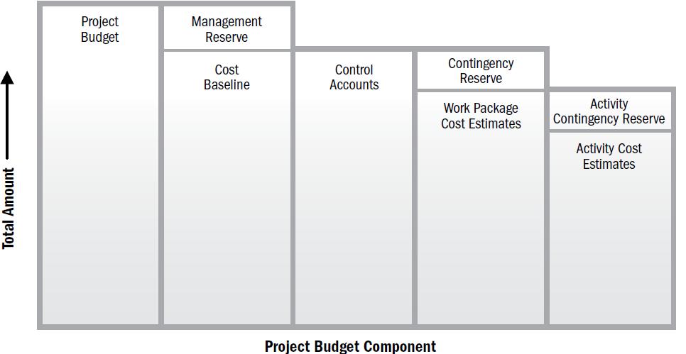
Determine budget
Output: Cost Baseline
A Contingency Reserve is a budget or time buffer built into the project plan to address identified risks — those you know might happen, but you're not sure when or how severely.
Contingency funds to allow for flexibility and reduce risks of budget overruns, usually 5-10% of the budget

Slide 30
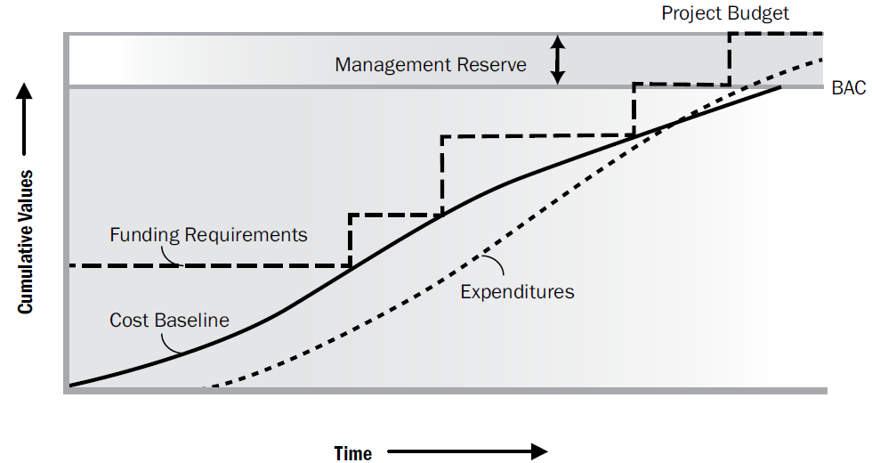
Determine budget
Output: Cost Baseline
A Contingency Reserve is a budget or time buffer built into the project plan to address identified risks — those you know might happen, but you're not sure when or how severely.
Contingency funds to allow for flexibility and reduce risks of budget overruns, usually 5-10% of the budget

Slide 31
Determine budget
Output: Project funding requirements
Total funding requirements and periodic funding requirements (e.g., quarterly, annually) are derived from the cost baseline.
Output: Project documents updates
Cost estimates
Project schedule
Risk register

Slide 32
Plan Quality
The process of identifying quality requirements and/or standards for the project and product, and documenting how the project will demonstrate compliance
Process
Output
Plan Quality
Quality management plan
Process improvement plan
Quality metrics
Quality checklist
Project document update

Slide 33
Plan Quality
Quality management
Project quality management includes the processes and activities that determine quality policies, objectives, and responsibilities so that the project will satisfy the need for which it was undertaken.
Quality vs. Grade
Quality
Grade
The degree to which a product or service meets the requirements
It answers: “Does it work well and as expected?”
A category or rank assigned to products or services having the same functional use but different technical characteristics.
It answers: “How feature-rich or sophisticated is it?”

Slide 34

High quality, high grade
High quality, low grade
works flawlessly with excellent build quality and uses premium components like a high-end processor and display (high grade). Samsung Galaxy S23 Ultra
works well and feels well-made (high quality), but it uses older or less advanced components like a mid-range processor or lower resolution screen (low grade). Samsung Galaxy A14 or XIAOMI Phones
Low quality, high grade
Low quality, low grade
uses premium parts (high grade), such as a flagship camera sensor or OLED display, but the assembly is poor, causing frequent crashes or screen flickering (low quality) Samsung Galaxy Note 7
cheaply made and uses low-end parts (low grade), like a slow processor and low-quality screen, resulting in poor performance and frequent issues (low quality).

Slide 35

High quality, high grade
High quality, low grade
It’s cooked correctly and safe to eat (high quality), and it uses a high grade of cheese and other ingredients that make it desirable
cooked correctly and safe to eat (high quality), but it might use low-grade cheese or have unhealthy ingredients that make it less desirable (low grade).
Low quality, high grade
Low quality, low grade
good ingredients (high grade). However, the pizza arrives burnt and inedible! Although the grade is high, the quality is low.
Pizza arrives burnt and inedible (low quality) with low-grade cheese or have unhealthy ingredients that make it less desirable (low grade).

Slide 36
Plan Quality
Precision vs. Accuracy
Precision
Accuracy
Value of repeated measurements are clustered and have little scatter.
Measured value are not necessarily accurate
Measured value is very close to the true value
A very accurate measurement is
not necessarily precise

Slide 37
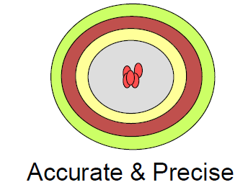


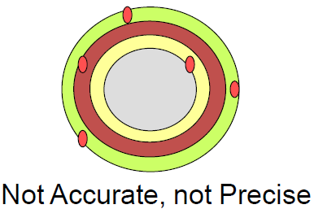
Plan Quality
Precision vs. accuracy

Slide 38
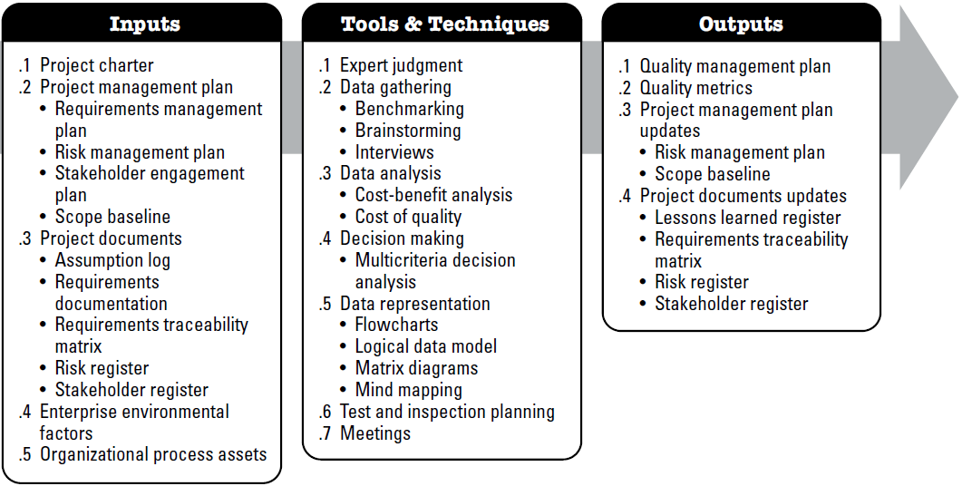
Plan Quality

Slide 39
Plan Quality
Input:
PROJECT MANAGEMENT PLAN
Requirements management plan, Risk management plan, Stakeholder engagement plan, Scope baseline
PROJECT DOCUMENTS
Assumption log.
Project Charter
contains the project approval requirements, measurable project objectives, and related success criteria that will influence the quality management of the project.
EEF - Governmental agency regulations; Rules, standards, and guidelines specific to the application area; Geographic distribution; Marketplace conditions; Working or operating conditions of the project or its deliverables;
EEF & OPA
Requirements documentation , Requirements traceability matrix
OPA - policies, procedures, and guidelines; Quality templates such as check sheets, traceability matrix, and others; and Historical databases and lessons learned repository
Risk register.
Stakeholder register.

Slide 40
Plan Quality
Tools & Techniques: Expert judgment
Expertise should be considered from individuals or groups with specialized knowledge or training in the following topics:
  Quality assurance,
  Quality control,
  Quality measurements,
  Quality improvements, and
  Quality systems.

Slide 41
Plan Quality
Tools & Techniques: Data gathering
  Benchmarking
  Brainstorming,
  Interviews
Tools & Techniques: Data Analysis
  Cost benefit analysis
  Cost of quality

Slide 42
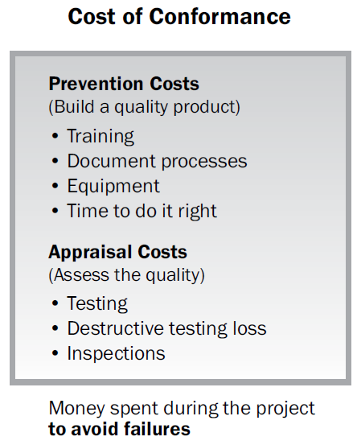
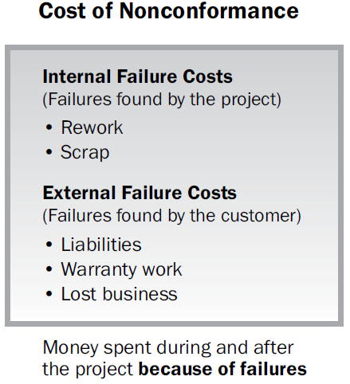
Plan Quality
Cost of Quality

Slide 43
Quiz
Your team is developing HealthTracker, a mobile app for medicine reminders. During development, the company spent $1,500 on developer training, $2,000 on automated testing tools, and $1,200 on manual QA testing, but skipped full regression testing due to time pressure. After release, users reported bugs — reminders didn’t work on some devices. Fixing and retesting cost $3,500. To retain users, the company gave free premium access worth $1,800, and negative reviews led to a loss of $2,700 in potential sales. Based on this scenario, calculate the Cost of Conformance (CoC) and the Cost of Non-Conformance (CoNC), and reflect on how better quality planning could have reduced post-release losses.
Cost of Conformance (CoC):
Developer training: $1,500
Automated testing tools: $2,000
Manual QA testing: $1,200
Total CoC = $4,700
Cost of Non-Conformance (CoNC):
Bug fixing and retesting: $3,500
Free premium access compensation: $1,800
Lost sales due to negative reviews: $2,700
Total CoNC = $8,000

Slide 44
Plan Quality
Tools & Techniques: Decision making
  Multicriteria Decision analysis
Tools & Techniques: Data representation
  Flowcharts (SIPOC (suppliers, inputs, process, outputs, and customers))
  Logical data model - visual representation of an organization’s data, described in business language
  Matrix diagrams - identifying the key quality metrics that are important for the success of the project.
  Mind mapping
Tools & Techniques: Test and inspection planning
Tools & Techniques: Meetings

Slide 45
Plan Quality
Output:
Quality management plan
It describes how the project management team will implement the performing organizations' quality policy
Process improvement plan
Process boundary, configuration, metric, target for improved performance
Quality metrics
On time performance, budget control, defect frequency, failure rate, availability, reliability etc
Used to verify required sets of steps performed
Quality checklist
Stakeholder register
Project document update
Responsibility assignment matrix

Slide 46
Plan Resource Management
The process of defining how to estimate, acquire, manage, and utilize physical
and team resources
Process
Output
Plan Resource Management
Resource management plan
Team Charter
Project Documents update

Slide 47
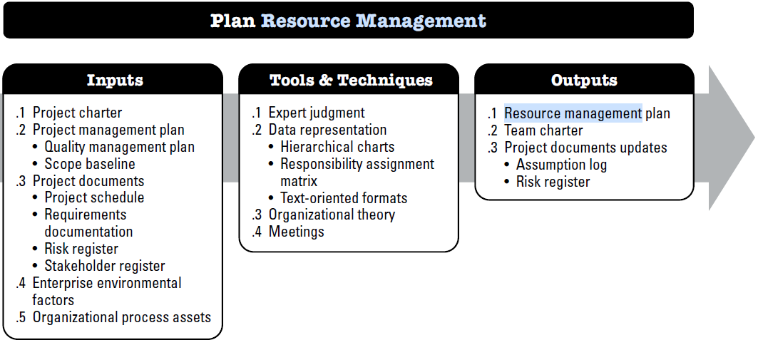
Plan Resource Management

Slide 48
Plan Resource Management
Input:
PROJECT MANAGEMENT PLAN
Quality management plan
PROJECT DOCUMENTS
Project schedule, Requirements Documentation, Risk register, Stakeholder register
Project Charter
The project charter provides the high-level project description and requirements. It also has the key stakeholder list, summary milestones, and preapproved financial resources that may influence the resource
EEF - Organizational culture and structure, Geographic distribution of facilities and resources, Existing resources competencies and availability,
EEF & OPA
OPA - Human resource policies and procedures, Physical resource management policies and procedures, Safety policies, Security policies, Templates for the resource management plan, and Historical information for similar projects
Scope baseline
management of the project.

Slide 49
Plan Resource Management
Tools & Techniques: Expert judgment
Expertise should be considered from individuals or groups with specialized knowledge or training in the following topics:
  Negotiating for the best resources within the organization;
  Talent management and personnel development;
  Determining the preliminary effort level needed to meet project objectives;
  Determining reporting requirements based on the organizational culture;
  Estimating lead times required for acquisition, based on lessons learned and market conditions;
  Identifying risks associated with resource acquisition, retention, and release plans;

Slide 50
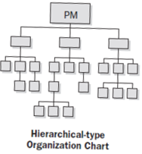
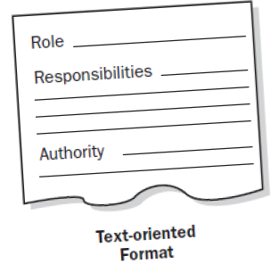
Plan Resource Management
Tools & Techniques: Data Representation
Hierarchical charts
Assignment Matrix – RACI (responsible, accountable, consult, and inform)
Text-oriented formats

Slide 51
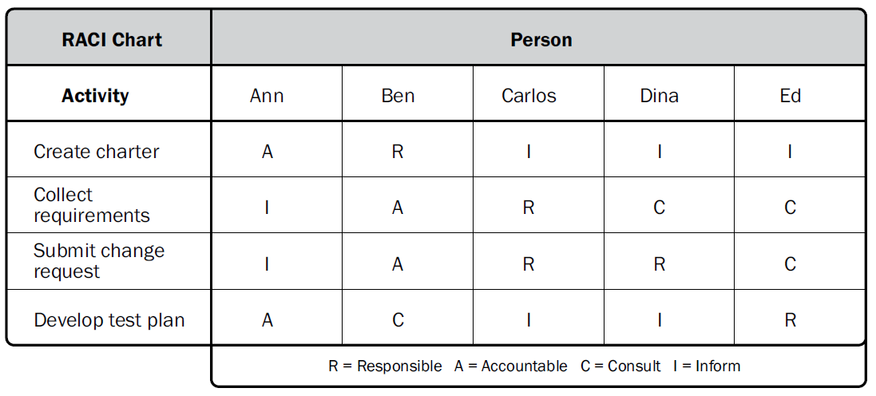
Plan Resource Management
Tools & Techniques: Data Representation
Hierarchical charts
Assignment Matrix – RACI (responsible, accountable, consult, inform)
Text-oriented formats

Slide 52
Plan Resource Management
Tools & Techniques: Organizational theory
Provides information regarding the way in which people, teams and organizational units behave.
Tools & Techniques: Meetings
To reach consensus on project human resource plan.

Slide 53
Plan Resource Management
Output: Resource management plan
Identification of resources- Methods for identifying and quantifying team and physical resources needed.
Acquiring resources. Guidance on how to acquire team and physical resources for the project.
Roles and responsibilities: Role, Authority, responsibility, competence
Project organization charts.
Project team resource management. Guidance on how project team resources should be defined, staffed, managed, and eventually released.
Training. Training strategies for team members.
Team development. Methods for developing the project team.
Resource control. Methods for ensuring adequate physical resources are available as needed and that the acquisition of physical resources is optimized for project needs.
Recognition Plan. Which recognition and rewards will be given to team members, and when they will be given.

Slide 54
Plan Resource Management
Output: Team charter
Team values,
Communication guidelines,
Decision-making criteria and process,
Conflict resolution process,
Meeting guidelines, and
Team agreements.
Output: Project documents Updates
Assumption log
Risk Register

Slide 55
Estimate Activity Resources
Estimate Activity Resources is the process of estimating team resources and the type and quantities of materials, equipment, and supplies necessary to perform project work.
Process
Output
Estimate Activity Resources
Resource Requirements
Basis of estimates
Resource Breakdown Structure
Project documents updates

Slide 56
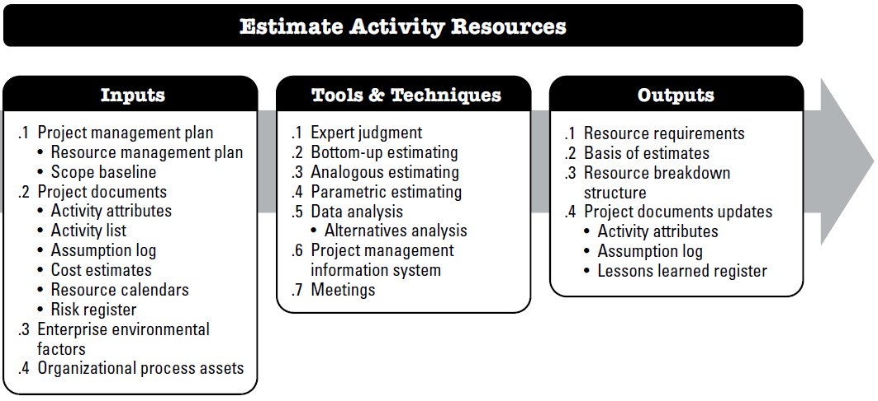
Estimate Activity Resources

Slide 57
Estimate Activity Resources
Input:
PROJECT MANAGEMENT PLAN
Resource management plan
PROJECT DOCUMENTS
Activity attributes, Activity list, Assumption log, Cost estimates, Resource calendars, Risk register
EEF - Resource location, Resource availability, Team resource skills, Organizational culture, Published estimating data, and Marketplace conditions.;
EEF & OPA
OPA - Policies and procedures regarding staffing, Policies and procedures relating to supplies and equipment, and Historical information regarding types of resources used for similar work on previous projects
Scope baseline

Slide 58
Estimate Activity Resources
Tools & Techniques:
Expert judgment
Bottom-up estimating
Analogous estimating
Parametric estimating
Data analysis
Project management information system
Meetings

Slide 59
Estimate Activity Resources
Output:
Resource Requirements
identification and description of the types and quantities of resources required for each scheduled activity in a work package
Basis of estimates
The method used to develop the estimate, Resources used to develop the estimate, Assumptions associated with the estimate, Known constraints, Range of estimates, Confidence level of the estimate, and Documentation of identified risks influencing the estimate.
Resource Breakdown Structure
A composite resource calendar for the project documents working days and nonworking days that determine those dates on which a specific resource, whether a person or materiel, can be active or is idle
Activity Attributes, Assumption log, LL register
Project Document Updates

Slide 60
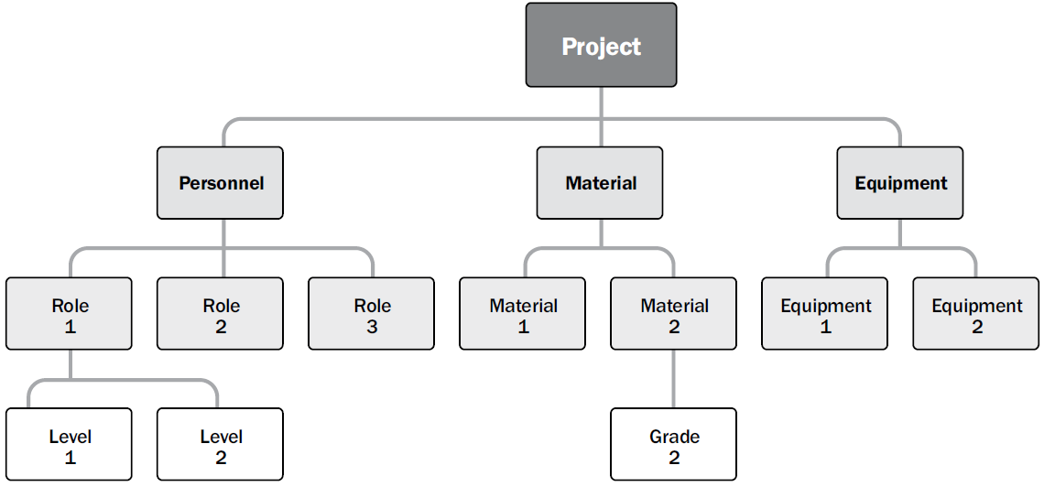
Estimate Activity Resources
Sample Resource Breakdown Structure

Slide 61
Plan communication Management
The process of developing an appropriate approach and plan for project communication activities based on the information needs of each stakeholder or group, available organizational assets, and the needs of the project.
Process
Output
Plan Communication Management
Communication management plan
Project documents updates

Slide 62
Plan communication Management
Why plan communication
Determining the information needs of the stakeholders and defining the communication approach.
    ▪ Who
    ▪ What
    ▪ When
    ▪ How
    ▪ By whom
Effective communication means that the info is provided in the right format, right time, right impact…
Efficient communication means providing only the info that is needed

Slide 63
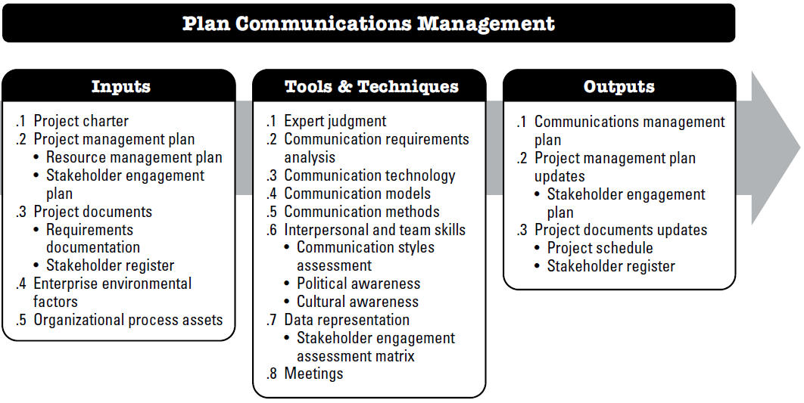
Plan communication Management

Slide 64
Plan communication Management
Input:
PROJECT MANAGEMENT PLAN
Resource management plan
PROJECT DOCUMENTS
Requirement documentation
Project Charter
The project charter identifies the key stakeholder list. It may also contain information about the roles and responsibilities of the stakeholders.
EEF - Organizational culture, political climate, and governance framework; Personnel administration policies; Stakeholder risk thresholds; etc;
EEF & OPA
OPA - Organizational policies and procedures for social media, ethics, and security, Organizational communication requirements
Stakeholder engagement plan
Stakeholder register

Slide 65
Plan communication Management
Tools & Techniques:
Expert judgment
Communication requirements analysis
Communication technology
Communication models
Communication methods
Interpersonal and team skills
Data representation
Meetings

Slide 66
Plan communication Management
Tools & Techniques: Communication requirement analysis
Analysis of communication requirements determines the information needs of the project stakeholders.
These requirements are defined by combining the type and format of information needed with an analysis of the value of that information.
Two People
One Channel
Three People
Three Channel
Four People
Six Channel
Five People
Ten Channel
For n number of persons, Number of Communication Channels = n(n-1)/2

Slide 67
Plan communication Management
Tools & Techniques: Communication technology
Factors that affect communication technology selection
    •Urgency of need for information
    •Availability of technology
    •Ease of use
    •Project environment
    •Sensitivity of information

Slide 68
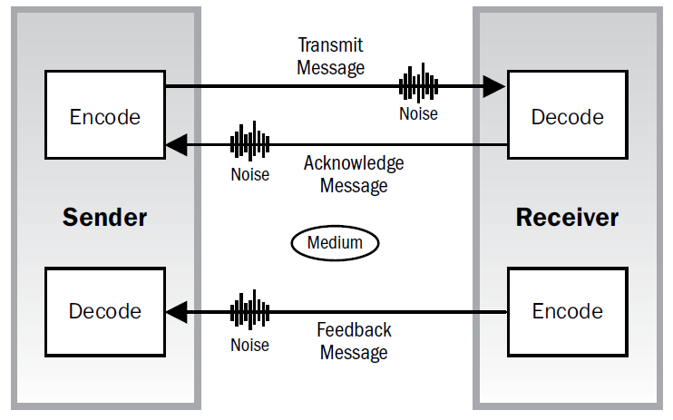
Plan communication Management
Tools & Techniques: Communication Model
Sample basic sender/receiver communication model (encode-transmit-decode)
Sample interactive communication model (ack & feedback)

Slide 69
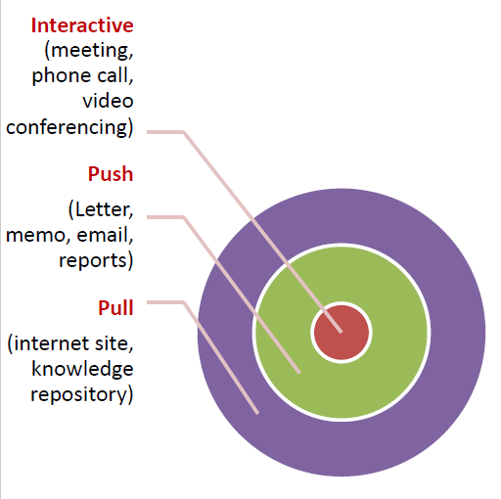
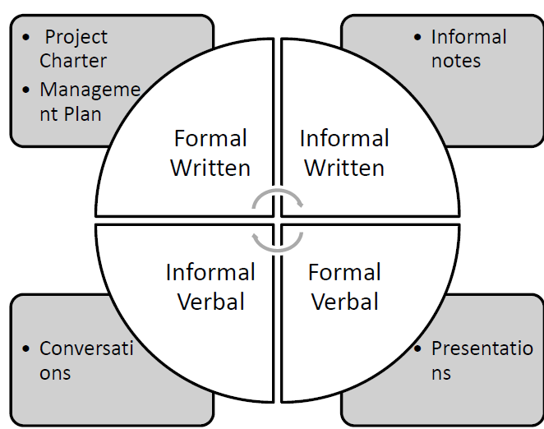
Plan communication Management
Tools & Techniques: Communication Methods
communication methods
Types of communication

Slide 70
Plan communication Management
Tools & Techniques: Interpersonal and team skills
  Communication styles assessment
  Political and cultural awareness
Tools & Techniques: Data representation
  stakeholder engagement assessment matrix.
Tools & Techniques: Meetings
  Project meetings can include virtual (e-meetings) or face-to-face meetings, and can be supported with document collaboration technologies, including email messages and project websites.

Slide 71
Plan communication Management
Output:
COMMUNIATION MANAGEMENT PLAN
Stakeholder communication requirements, information to be communicated, reason of distribution, time frame and frequency, person responsible for communicating & authorizing,
PROJECT MANAGEMENT PLAN UPDATE
The stakeholder engagement plan is updated to reflect any processes, procedures, tools, or techniques that affect the engagement of stakeholders in project decisions and execution.
Project schedule, Stakeholder register
PROJECT DOCUMENT UPDATE

Slide 72
Plan communication Management
Communication Type | Objective of Communication | Medium | Frequency | Audience | Owner | Deliverable
Project Team Meetings | Review status of the project with the team. | Face to Face/ Conference Call | Twice a month | Project Team | Project Manager | Agenda Meeting Minutes
Technical Design Meetings | Discuss and develop technical design solutions for the project. | Face to Face | As Needed | Project Technical Staff | Technical Lead | Agenda Meeting Minutes
Project Status Reports | Report the status of the project including activities, progress, costs and issues. | Email | Monthly | Project Sponsor Project Team Stakeholder PMO | Project Manager | Project Status Report

